Slide 1




Controllers, Templating, Forms
Returning Views, using Twig, submitting forms
PHP MVC Frameworks
Veselin Malezanov
Technical Trainers
Software University
http://softuni.bg

Slide 2


Table of Contents
Templating
Forms

Slide 3
Have a question?
#sli.do
#PHP-WEB

Slide 4


Templating
Templates, Twig

Slide 5
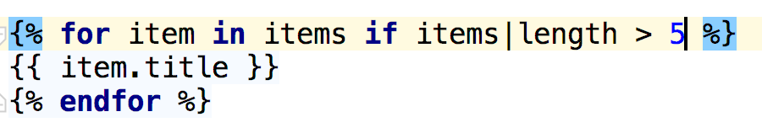
Templating
In Symfony you can use two type of templates
php - standard html + php code in our templates
twig - flexible template language

Slide 6
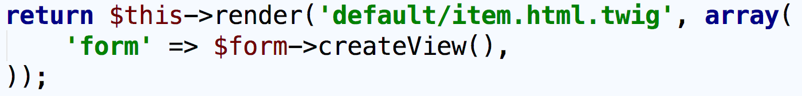
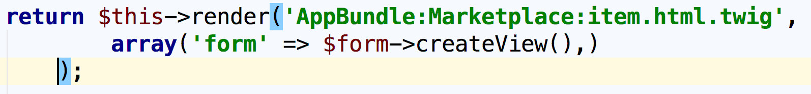
Templating
Templates Location
per application - templates can be accessed from any bundle
per bundle - templates can be accessed from any bundle using the namespace notation

Slide 7
Templating
Twig
Templating language
Easier to read
Creates much cleaner templates
Combines iteration with condition
Allows inheritance between templates
Automatic escaping and raw output
Extensions

Slide 8
Templating
Twig and Controllers
pass parameters to template
$this->render() - render template and create Response object
$this->renderView() - render template and return content as string

Slide 9
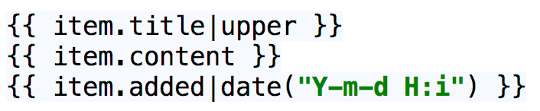
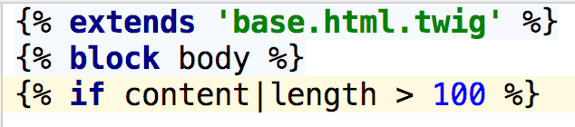
Templating
Twig
{{ … }} - print variable or text
{% ... %} - used for logic blocks
{# … #} - twig comment

Slide 10
Templating
What can we do with Twig?
extend template
combine conditional statements and loops
access object property with dot notation
generate links
override blocks, create macros, extend parent block
include another template
include assets
create custom twig extensions

Slide 11
Templating
What can we do with Twig?
app.user - get current user
app.request - get current request
app.session - get session
app.environment - get application environment
app.debug - check debug status of the application
access global twig variable - can create global twig variables and access them in your templates

Slide 12
Problem 1:
Create Twig template
Templating
Problem 2:
Test Twig capabilities

Slide 13
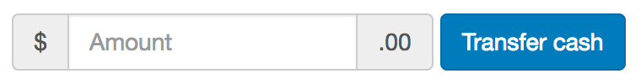
Forms
Forms and Templates

Slide 14
Forms
Form flow
create the form
set the data
handle request
do something with submitted data
save to database
remove from database
update database

Slide 15
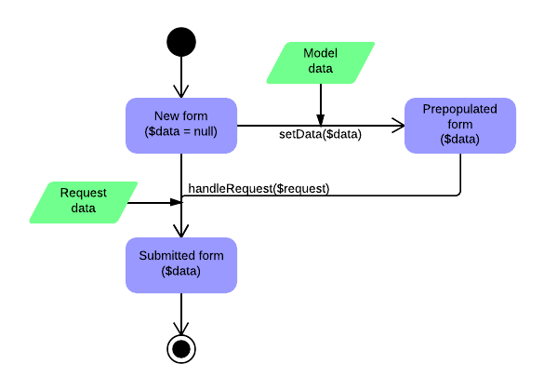
Forms
Form flow

Slide 16
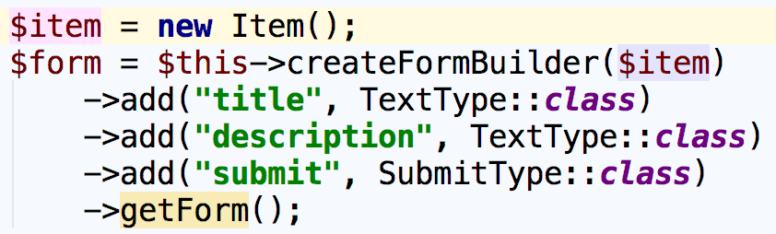
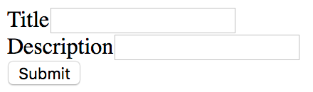
Forms
Two ways to create forms in Symfony
in your controller action using the form builder

Slide 17
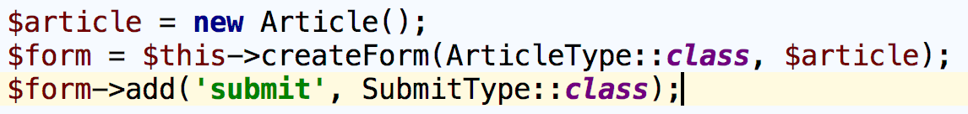
Forms
Two ways to create forms in Symfony
or using separate form class

Slide 18
Forms
Form Field Types
A form should know what input field to render
TextType - input type="text"
SubmitType - input type="submit"
ChoiceType - generates select, checkboxes or radio buttons
HiddenType - input type="hidden"
RepeatedType - used to render input fields for passwords and confirmation

Slide 19
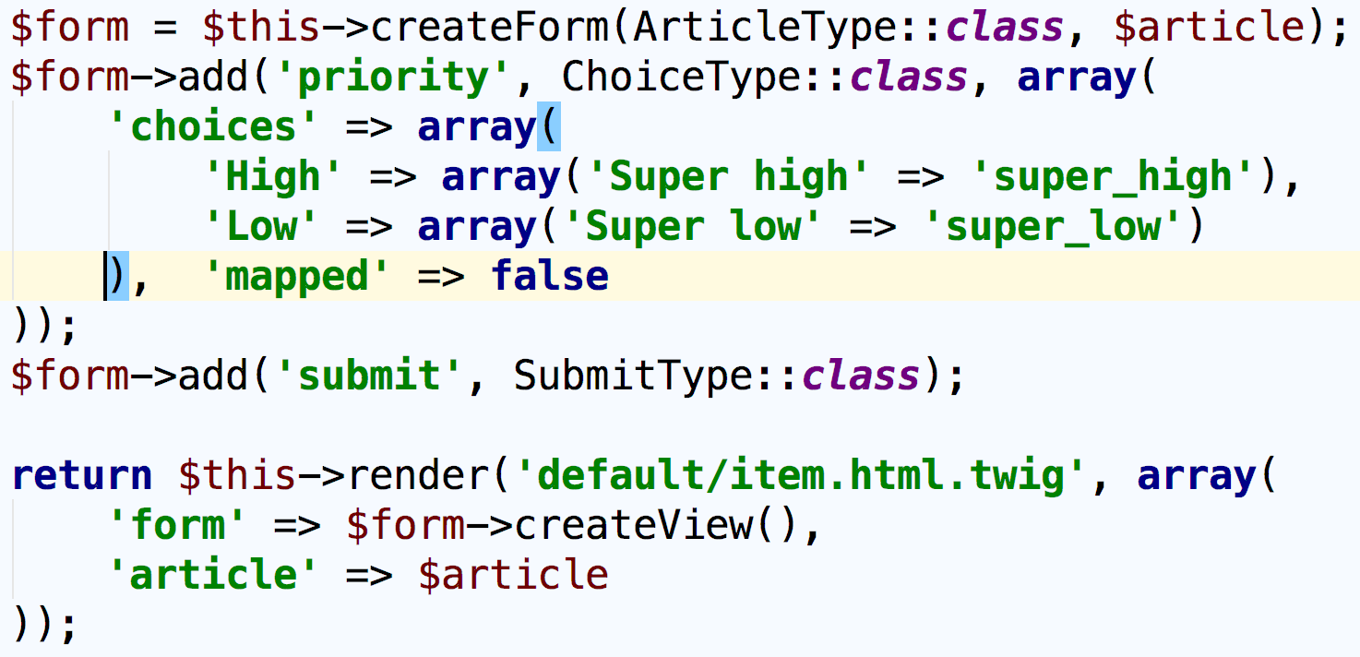
Forms
To display form in template it must be passed as view parameter

Slide 20
Forms
Problem 1:
Create simple form
Problem 2:
Modify form, use different rendering methods

Slide 21
Summary
Controllers - Create controllers, actions, 5-10-20 rule
Routing - Define routes, configuration, route parameters
Templating - Twig, extending templates, blocks, Twig extensions, macros
Forms - Rest concepts, REST URIs, Responses

Slide 22
REST Controllers and Routing
https://softuni.bg/courses/

Slide 23
License
This course (slides, examples, demos, videos, homework, etc.) is licensed under the "Creative Commons Attribution-NonCommercial-ShareAlike 4.0 International" license

Slide 24



Trainings @ Software University (SoftUni)
Software University – High-Quality Education, Profession and Job for Software Developers
softuni.bg
Software University Foundation
softuni.org
Software University @ Facebook
facebook.com/SoftwareUniversity
Software University Forums
forum.softuni.bg

